Slide 1
Exploitation - MSF
Offensive Security

Slide 2
Metasploit Framework
Penetration testing framework
Rapid7 (2009-Present)
Hdmoore, et al. (2003-2009)
Open source
Extending msf is encouraged
Over half million lines of code
Metasploit Unleased

Slide 3
Other exploitation frameworks
CORE Impact | Innuendo | Saint Exploit | Immunity Canvas
Very expensive
Base price ~25k-50k
Exploit modules often cost extra
Developed by the company and not open source
Basically unreleased exploits
Custom?

Slide 4
Metasploit Basics
More than just exploits
Many OS’s & architectures
Mostly written in ruby
Some parts C and ASM
End to end pentesting
Even though we don’t use it this way
Client for many protocols

Slide 5
MSF Design
Designed to be simple and consistent
You don’t need to understand ruby or protocols
Options should be consistent
Many exploit developers have contributed
Automation and extension
Easy to automate
Extensions built via Ruby

Slide 6
Metasploit Components
Auxiliary modules
Exploits
Payloads
Post modules
Encoders

Slide 7
Auxiliary Modules
Information gathering
Enumeration
Scanner, sniffers, crawlers
Fuzzers
Protocol/Application Servers
Admin
If you already have credentials

Slide 8
Exploits
~1800 exploits
Additions are somewhat frequent
Gets you code execution
Code execution itself is not in the exploit
use exploit/multi/handler

Slide 9
Payloads
Used in conjunction with exploits
What happens after code exection
Bind vs Reverse
Common payloads
Meterpreter
Shell
Command exec

Slide 10
Bind vs Reverse
Payloads often will have a bind or reverse option.
Bind will open a connection on the target and wait.
Pros?
Cons?
Defenses?
Reverse will make a connection back to the attacker.
Pros?
Cons?
Defenses?

Slide 11
TCP? HTTP? HTTPS
Payloads can use different types of protocols to get between point A and B
TCP
HTTP
HTTPS

Slide 12
Post Modules
After payload runs what’s next?
Post-exploitation
Gather and enumerate information on the system

Slide 13
Encoders
Used for encoding exploits
Changes how a character or string is represented
Cleaning up bad characters in an exploit
Bypassing AV

Slide 14

Module Information
All modules have metadata in the framework about them
Name
Description
Author
Disclosure date
Platform/Arch
License

Slide 15
Starting up Metasploit
msfconsole
Don’t need to start postgresql manually anymore
If your db is in a disconnected state
[-] Failed to connect to the database:
db_connect –y /usr/share/metasploit-framework/config/database.yml
Or
msfdb reinit
Notes:
Db_connect is within msf and will not delete previous data
Exiting Metasploit and msfdb reinit will lose data
After either of these run db_rebuild_cache

Slide 16
Search
Makes using Metasploit much easier
Search for exploits, payloads, aux modules, etc.

Slide 17
Workspace & Datastore
Workspaces
Allows you to keep msf clean and organized
workspace –h
Datastore
Msf environment
setg and unsetg

Slide 18
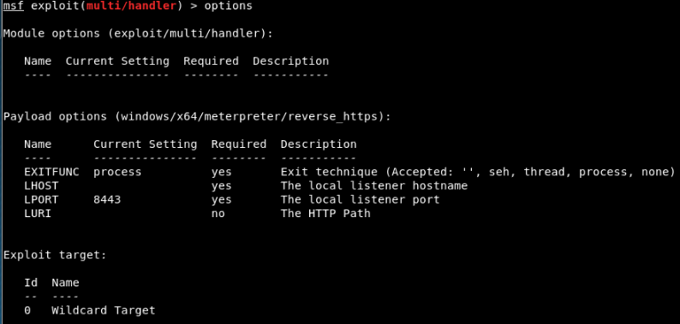
Options
Modules have options to configure them
Some are required:

Slide 19
Jobs & Sessions
Sessions = shells
sessions –i
Jobs
Running handlers or servers
exploit/multi/handler

Slide 20
Meterpreter
Upgraded shell with simplified functionality
Very powerful command shell
Runs entirely in memory – extremely difficult to detect, as it leaves no tracks
Doesn’t start a new process
Runs under the exploited process
Permissions?
“hacker’s cmd”

Slide 21
Meterpreter
Migrate
Download/Upload
Normal linux commands
Loading of other modules…
Powershell
Python
Kiwi

Slide 22
Exploit Development with MSF
Tools to aide in exploit dev
msfvenom
msfpayload & msfencode
pattern_create.rb & pattern_offset.rb
And more…

Slide 23
Playing on a team with MSF
Armitage (Free)
Teamserver
Free
MSF Pro ($)
Web interface
Cobalt Strike ($)
Version 2
Version 3+
Teamserver

Slide 24
Defending against MSF
Keep your systems patched…
Done
MSF doesn’t have special 0-days that can’t be patched
Remember that MSF is open source
Firewall
No port = no connection
IDS/IPS
Might catch some plain MSF exploits if you don’t modify them
i.e. Shellshock

Slide 25
Digging in deeper
Metasploit Unleashed from Offensive Security
Free
Penetration Testing with Kali (PWK) from Offensive Security
Training & OSCP
Cracking the Perimeter (CTP) from Offensive Security
CTF’s & hackthebox

Slide 26
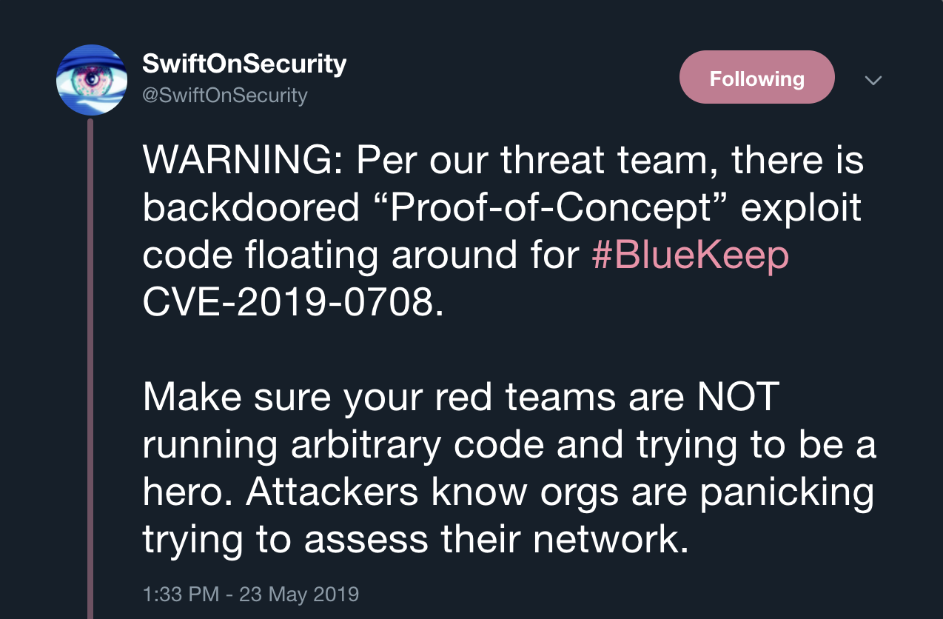
Further Exploitation
Finding exploits on the web
ExploitDB
Collection of curated exploits

Slide 27
